Slide 1
Notes:
Flag of Nigeria!
White - peace and honesty
Green - hope, joy and love and in many cultures have a sacred significance
http://www.vexillologymatters.org/nigerian-flag.htm

Slide 2
Notes:
Nigeria is located in Africa, this is a map of Africa and a few other locations in Africa~

Slide 3
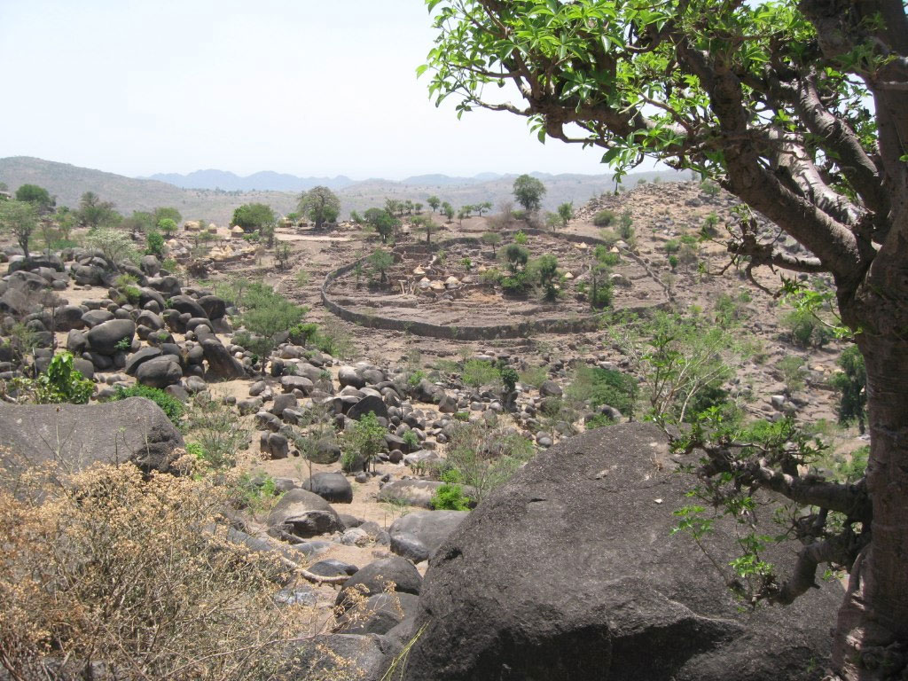
Notes:
This is the landscape of Nigeria~

Slide 4
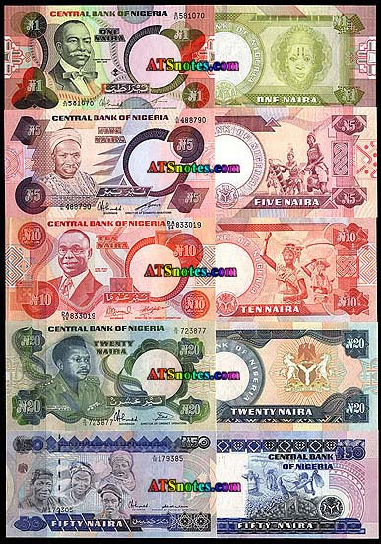
Notes:
Nigerian naira
Nigerian currency

Slide 5
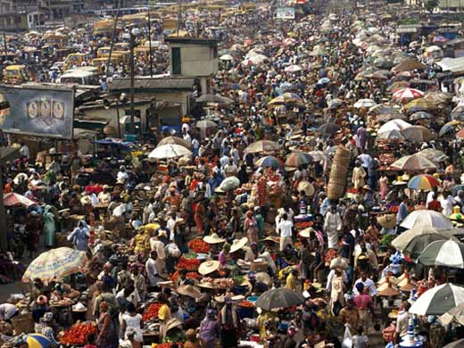
Notes:
Population: 162,470,737 (2011)
162 million people as of 2011, so its very overpopulated.

Slide 6
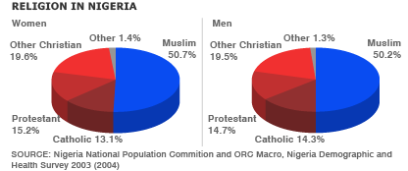
Notes:
Religion in Nigeria.
Half of Nigeria religion is muslim. While the other religions are Catholic, Protestant, Christian and other.

Slide 7
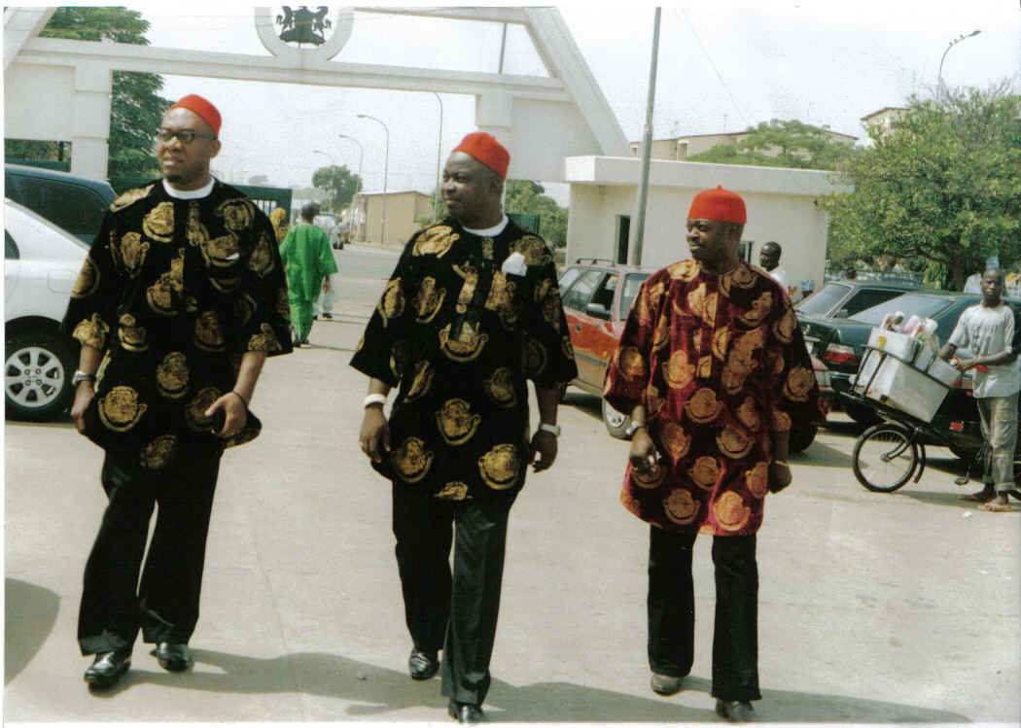
Notes:
Nigerian Men's traditional clothing
http://www.mapsofworld.com/nigeria/culture/clothing.html

Slide 8
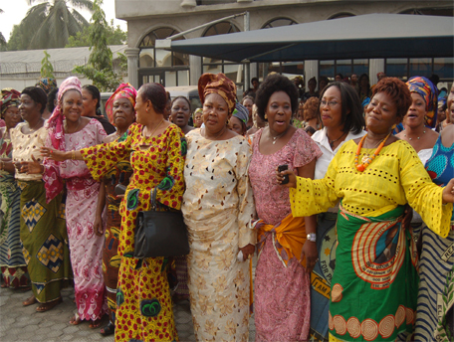
Notes:
Nigeria Women's traditional clothing
http://www.mapsofworld.com/nigeria/culture/clothing.html

Slide 9
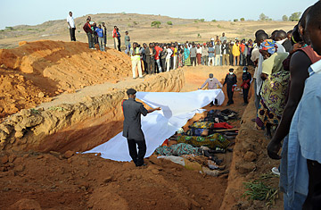
Notes:
http://www.time.com/time/world/article/0,8599,1971010,00.html

Slide 10
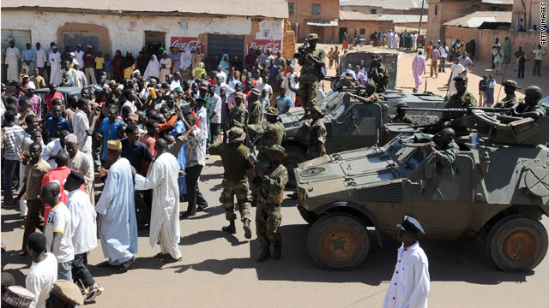
Notes:
Religion battle.

Slide 11
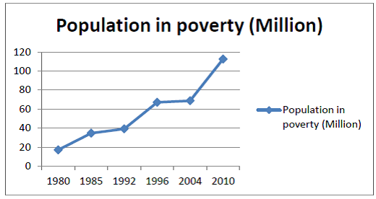
Notes:
Poverty rising chart.

Slide 12
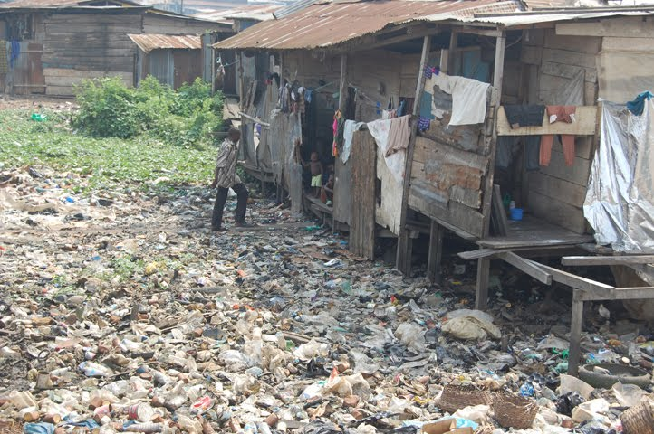
Notes:
http://www.bbc.co.uk/news/world-africa-17015873

Slide 13
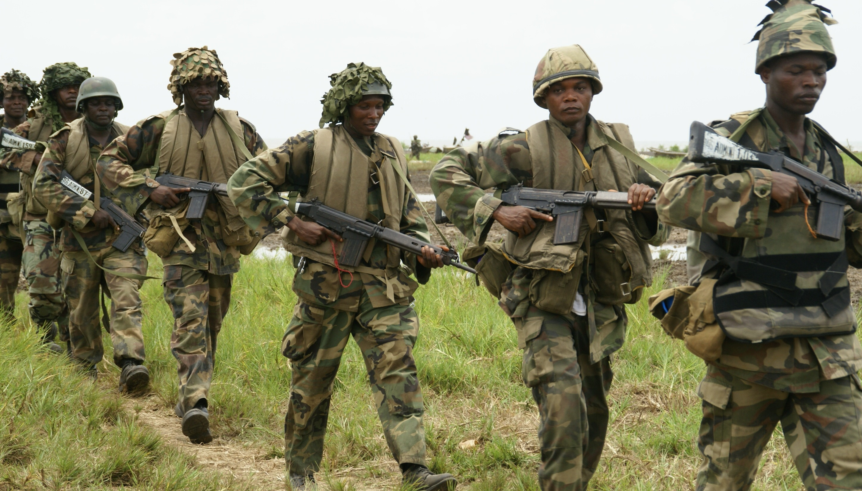
Notes:
Republic govt. Nigerian army.

Slide 14
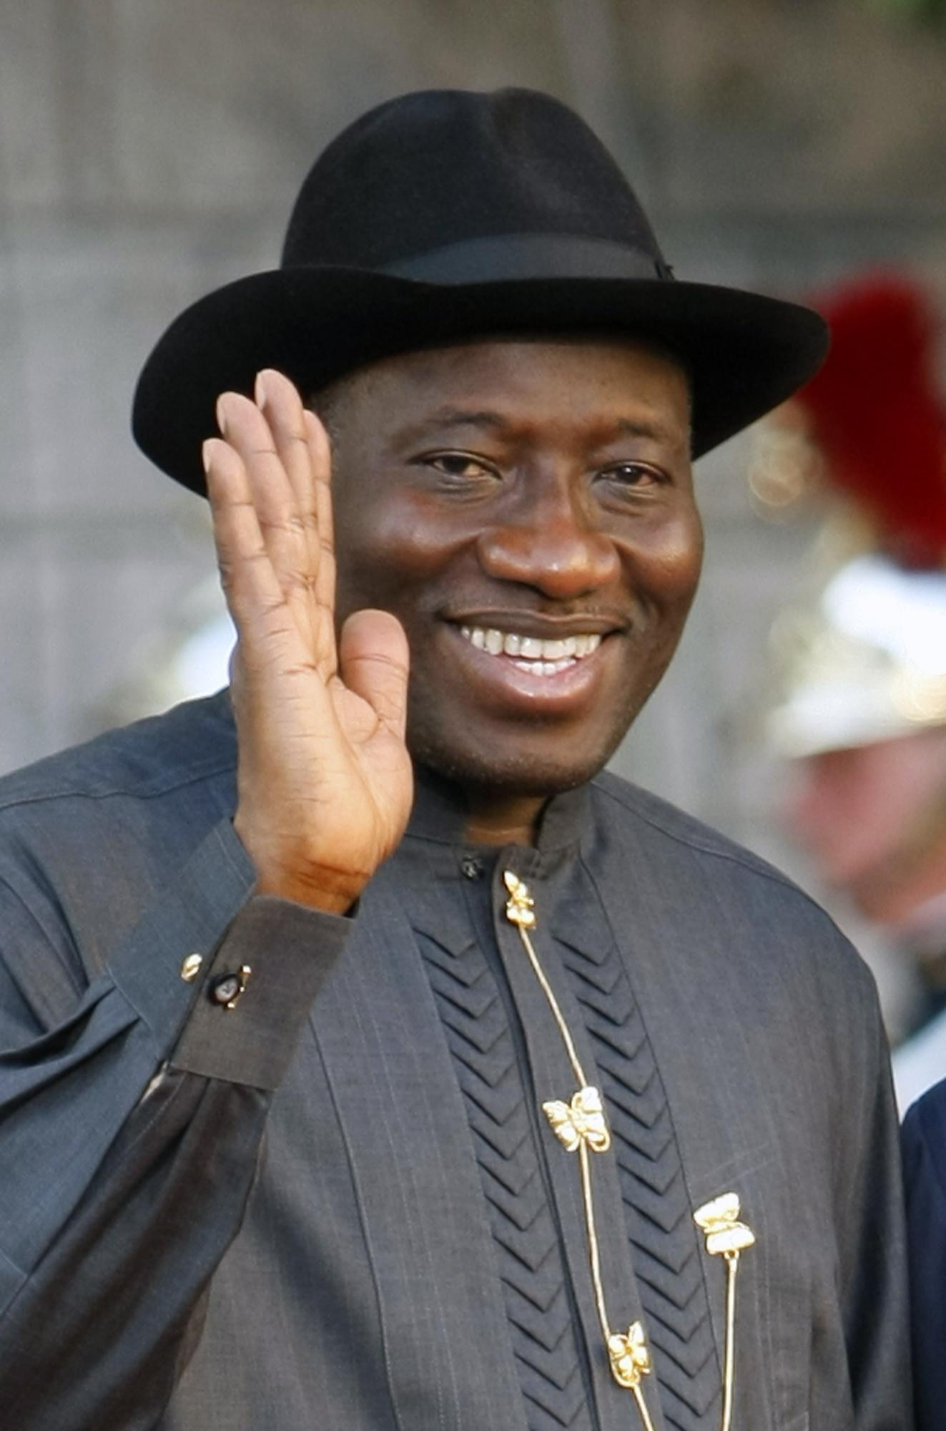
Notes:
Goodluck Jonathan – president

