Slide 1
World Wildlife Fund

Slide 2
Problem - Solution
There is many endangered species, the world being polluted, and too much human impact on the environment.
Everyone must know this in order to know why WWF was created, to help all the endangered species, conserve the world and have less human impact
Mission Statement; “To stop the degradation of the planet's natural environment and to build a future in which humans live in harmony with nature, by:
conserving the world's biological diversity,
ensuring that the use of renewable natural resources is sustainable,
promoting the reduction of pollution and wasteful consumption”

Slide 3
What is WWF & who gives them funding?
They are trying to stop degradation of the planet.
They want the earths biodiversity to stay healthy and vibrant, and to reduce the negative human impacts.
They focus on conserving critical places, and critical species that are important for habitat or people.
Reducing a humans ecological footprint
Most of the funding comes from charities and from many donators.

Slide 4
Problems and successes!
WWF has grown to become the worlds most largest and most respected independent conservation organizations.
It has over 5million people active in over 100 countries on 5 continents.
All though WWF has many problems, there is much pollution caused by human impact that pollutes the air and water, causing many animals to lose there habitats and as well as dying, causing extinction, and degrading the earth.

Slide 5
Size, workers & what makes it great?
WWF is the leading organization in wildlife conservation and endangered species.
It employs around 2500 full time staff.
There is over 5million supporters
The past 50years since it was founded, they invested $10 billion in more than 13,000 projects. It’s a great organization that’s getting bigger and just trying to help out the earth and the animals.

Slide 6
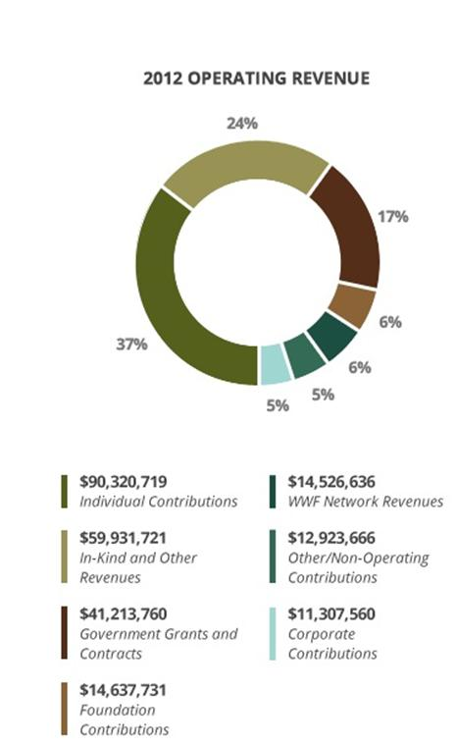
Donations go where?
37% goes to individual contributions, 24% in-kind and other revenues, 17% goes to government’s grants and contracts, 6% foundation contributions, 6% goes to WWF network revenues, 5% goes to other/non-operating contributions, 5% goes to corporate contributions.

Slide 7
How can you help?
You can help out WWF by giving donations.
You help just by keeping the environment clean and healthy just by being eco-friendly.
You can also adopt and endangered animal and receive a gift for helping.

